Slide 1
Patient Hospital Readmission
By: Alice Gwyn, Lynn Soors, Will Plaisance, Malika Shrestha & Silvio Zabala

Slide 2
Project Description
Develop a machine learning model to predict hospital readmission within 30 days of discharge. This model aims to:
Identify high-risk patients early
Prioritize interventions
Reduce readmission rates
Lower associated costs

Slide 3
Data Used
Centers for Medicare & Medicaid Services (CMS)
The Hospital Readmission Reduction Program public dataset provides readmission rates across hospitals nationwide.
https://data.cms.gov/provider-data/dataset/9n3s-kdb3#data-table
2. Hugging Face
Public Diabetes Readmission dataset.
https://huggingface.co/datasets/aai540-group3/diabetes-readmission

Slide 4



Research Questions
What variables has the strongest correlation with readmission risk?
Does the length of stay influence the probability of readmission?
How does hospital volume, as measured by the number of admissions and discharges, affect patient readmission rates?
How do readmission rates vary across regions that could benefit from a predictive model to reduce readmissions in highest readmission rates areas?
Which facilities have the highest readmission rates, where a readmission prediction model might have the greatest reduction in readmission rates and healthcare costs?

Slide 5
Why This Matters?
In the USA, over 3.5 million people are readmitted yearly, costing over $50 billion annually. Machine learning can predict readmission risk, potentially saving billions and improving patient outcomes.
Financial Burden: Readmissions cost the US healthcare system over $50 billion each year, with an average patient cost of $15,000 per readmission.
Patient Impact: Readmissions lead to worse health outcomes and erode patient confidence in healthcare.

Slide 6
Benefits of Machine Learning Prediction
Machine learning can provide many benefits to hospitals, including:
01
Cost Savings: Reduces unnecessary readmissions and associated expenses.
02
Improved Outcomes: Ensures timely intervention and prevents health decline.
03
Efficient Staffing: Optimizes resource allocation in hospitals.
04

Slide 7
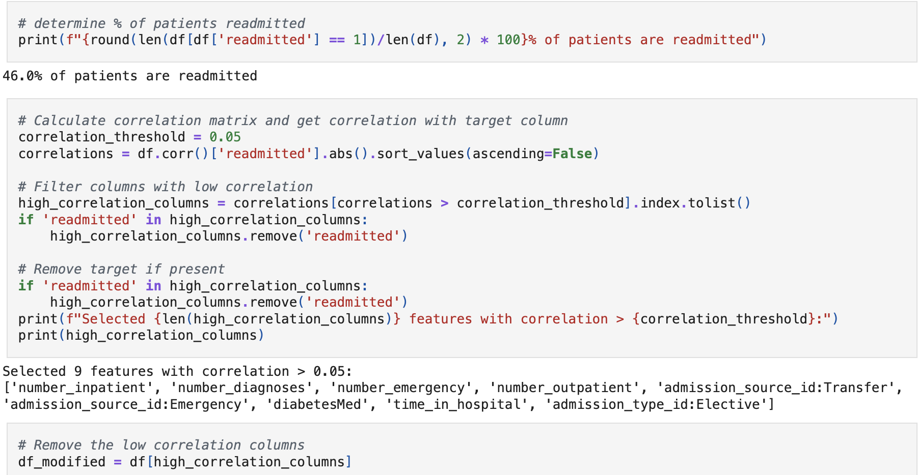
Exploratory Data Analysis & Feature Engineering
Readmission Rate: Calculated the percentage of patients readmitted to provide context on the target variable.
Correlation Analysis: Computed the correlation matrix with respect to the target (readmitted). Set a threshold (0.05) to filter out features with low correlation.
Feature Reduction: Created a modified DataFrame containing only the high-correlation features, reducing noise and dimensionality.

Slide 8
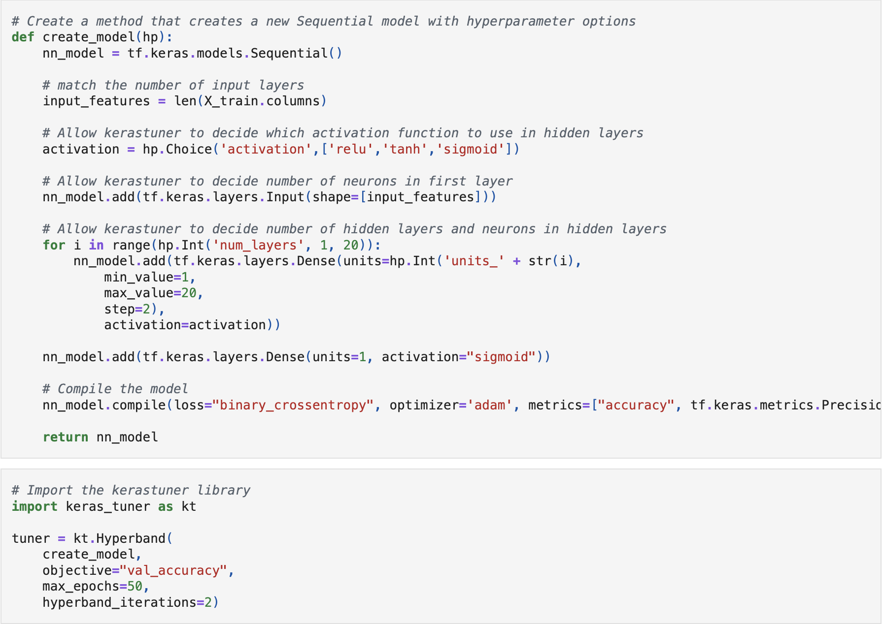
Model Building and hyperparameter tuning
Created a Hypermodel Function:
We built a sequential neural network with the architecture dynamically determined by Keras Tuner:
Input Layer: Set to the number of features from the training data.
Hidden Layers: Allowed the tuner to decide the number of layers between 1 and 20 and the number of neurons in each layer from 1 to 20 in steps of 2 as well as the activation function with a combination of either relu, tanh, and sigmoid.
Output Layer: Used a single neuron with sigmoid activation for binary classification.
Compilation:
Compiled the model with binary cross-entropy loss, the Adam optimizer, and metrics including accuracy and precision.
Setting Up the Tuner:
Configured the Hyperband tuner from Keras Tuner to optimize the model architecture based on validation accuracy.
Specified parameters such as max_epochs and hyperband_iterations.

Slide 9
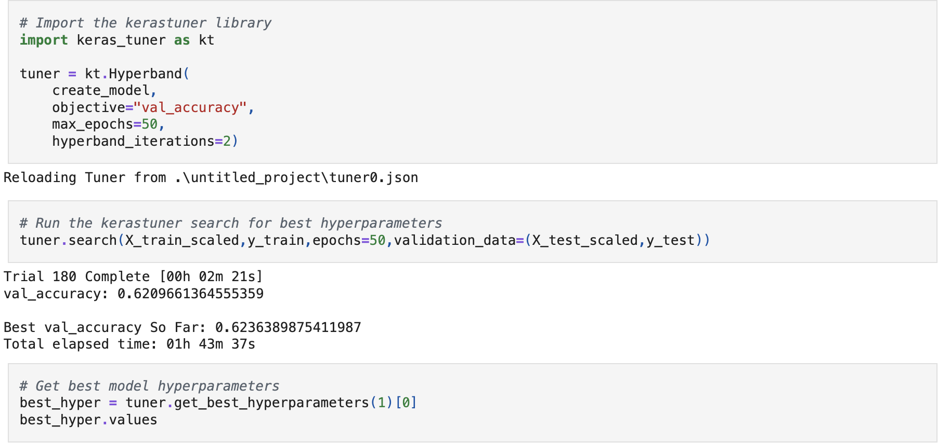
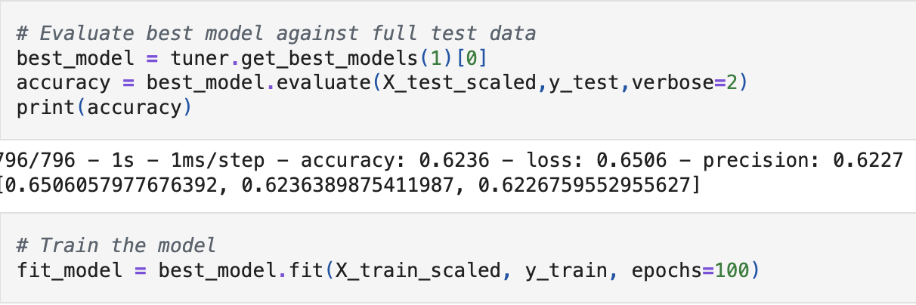
Model Optimization
Tuner Search:
Ran the hyperparameter search using the scaled training data and validation data.
Retrieved the Best Model:
Extracted the best hyperparameters and loaded the best model found by the tuner.
Initial Evaluation:
Evaluated the best model on the test set to get a baseline performance.
Final Evaluation:
Trained the best model further for 100 epochs on the training data to refine its performance.

Slide 10
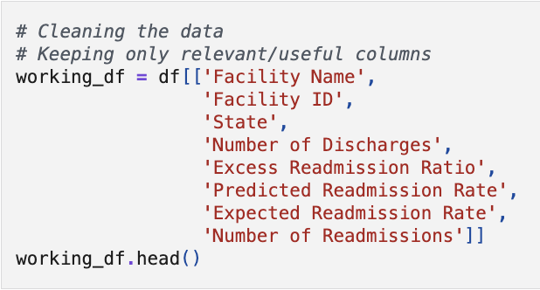
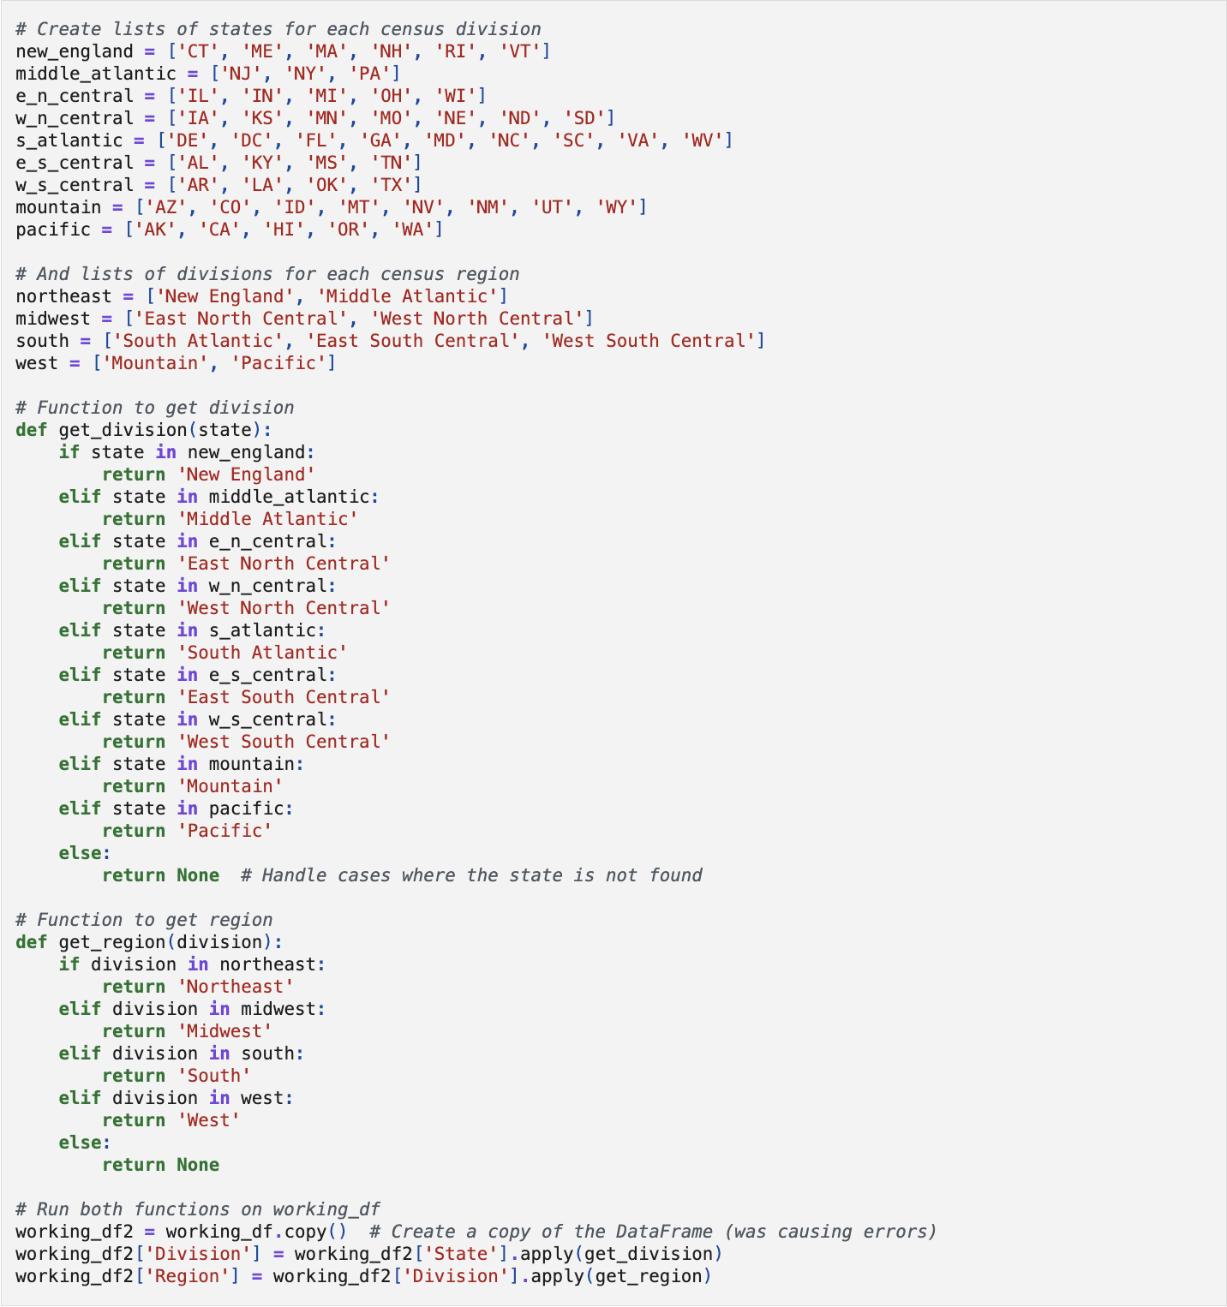
Hospital Data Cleaning & Geographical Feature Engineering
Selected Relevant Features
Defined lists of states for each census division (e.g., New England, Middle Atlantic, etc.).
Created a Division and Region columns.
Dropped rows with null values to clean data for analysis.

Slide 11
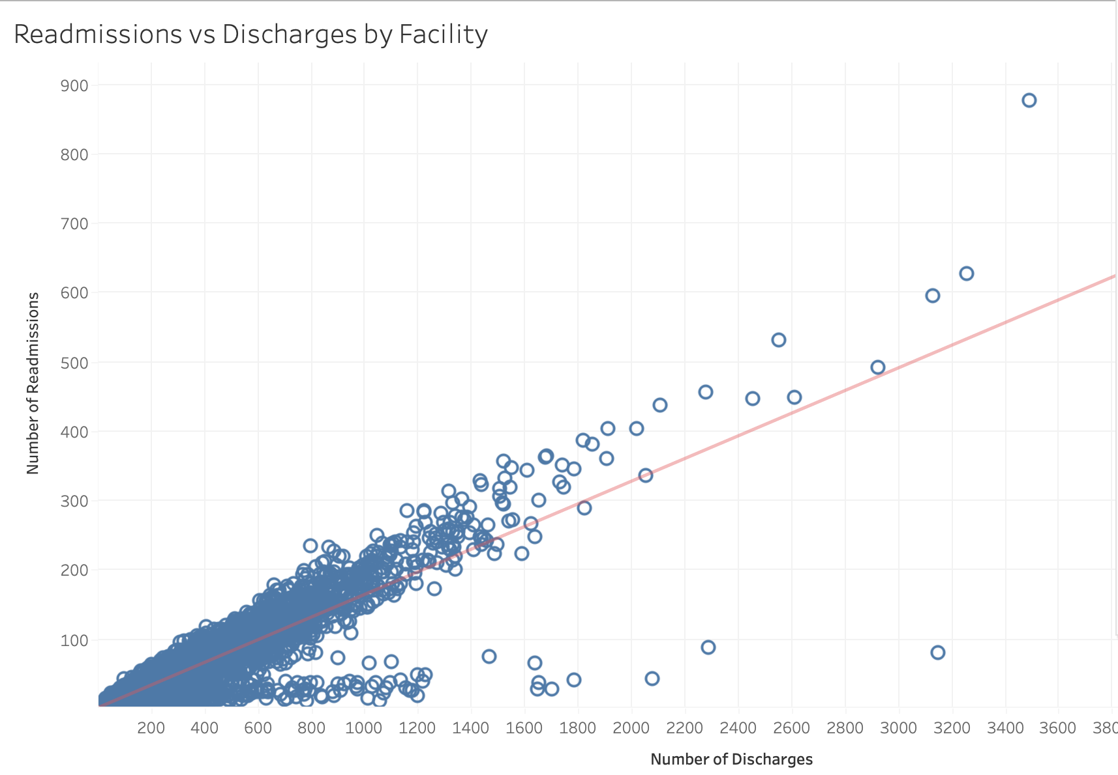
How does hospital volume, as measured by the number of admissions and discharges, affect patient readmission rates?
There is a noticeable variation in patient volumes across facilities.
As well as a strong visual correlation between hospital volume and readmission rate.

Slide 12
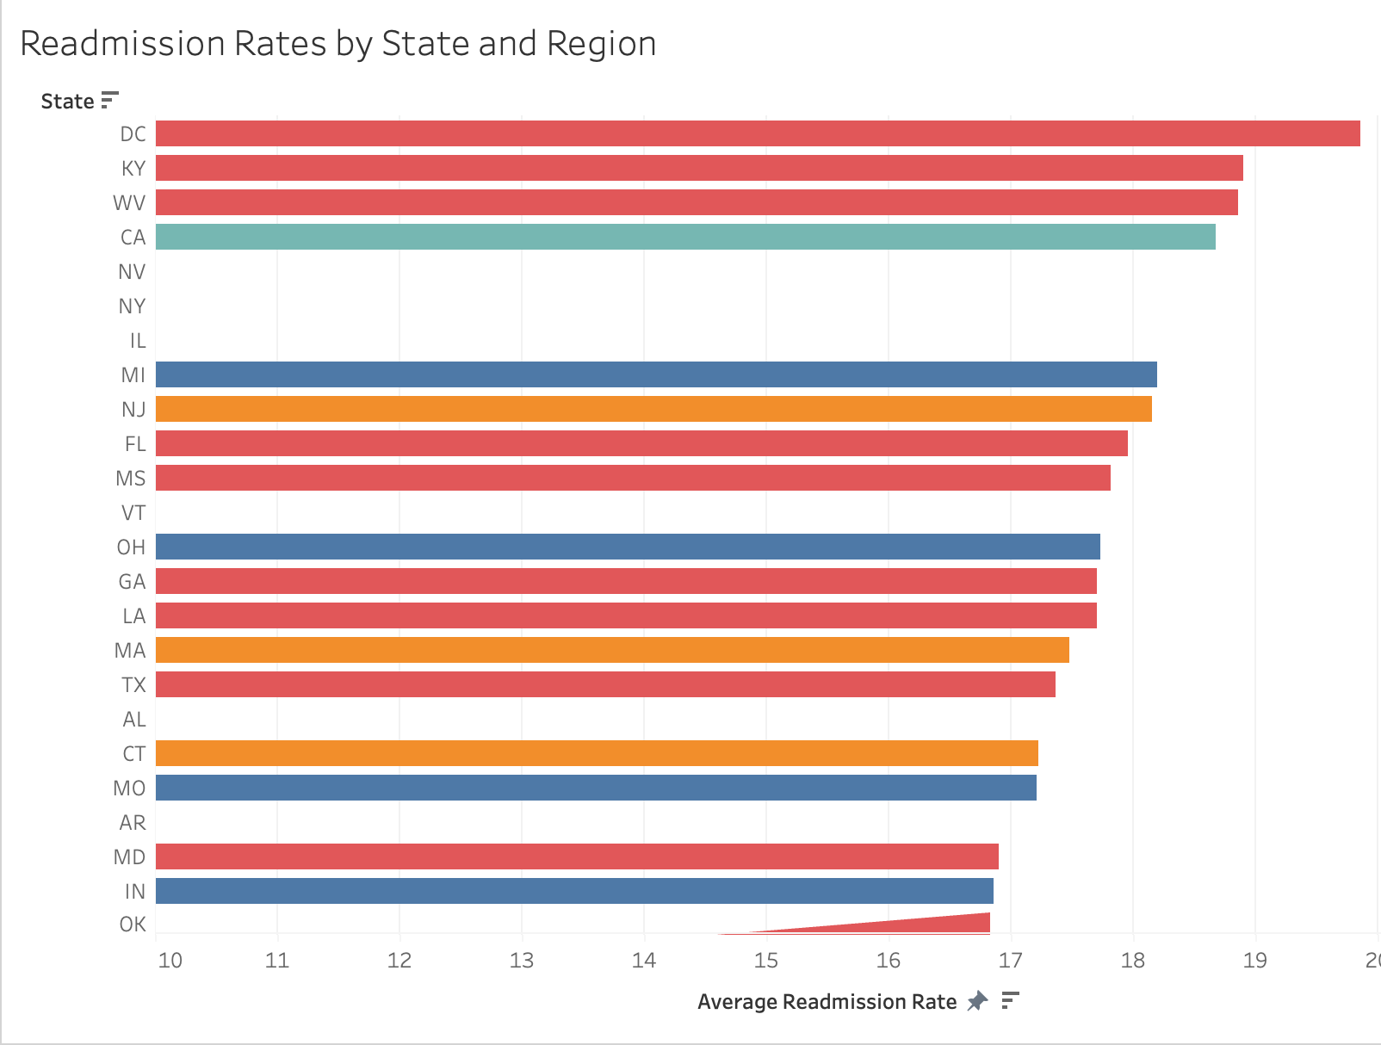
How do readmission rates vary across regions that could benefit from a predictive model to reduce readmissions in highest readmission rates areas?

Slide 13
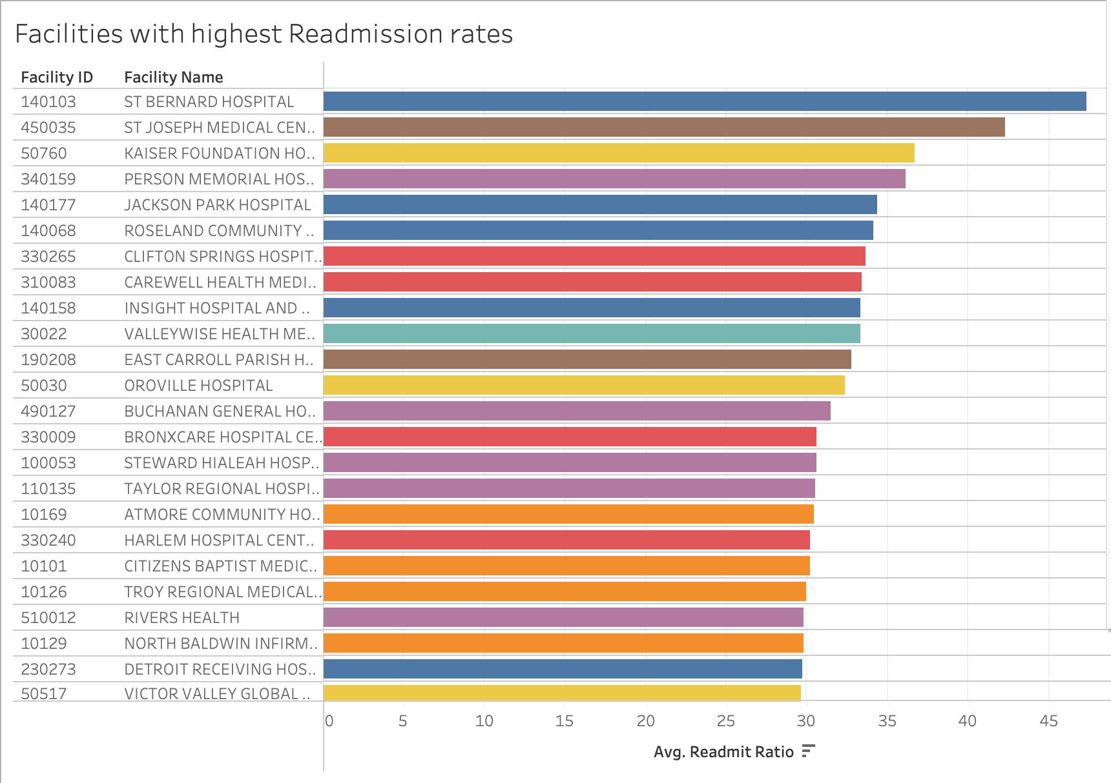
Which facilities have the highest readmission rates, where a readmission prediction model might have the greatest reduction in readmission rates and healthcare costs?

Slide 14
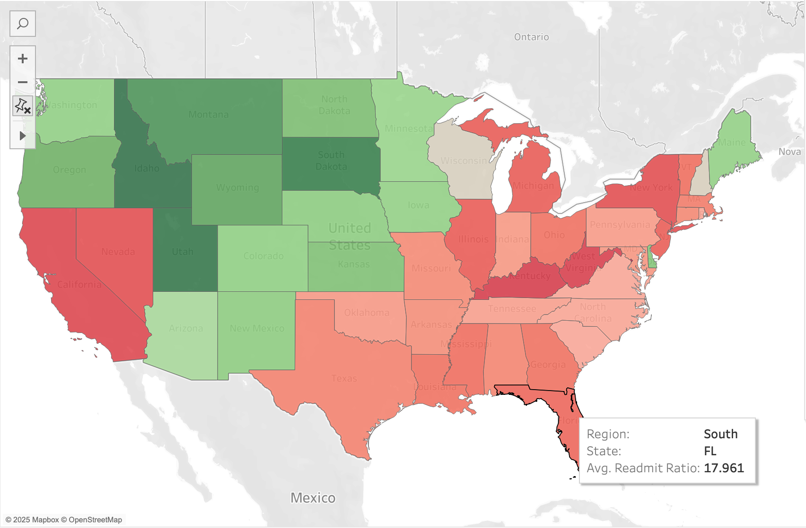
U.S. Readmission Rates by Region: A Geographical Overview
High-Level Overview:
Regions with above-average readmission rates may indicate resource constraints or patient population challenges.
Potential areas for targeted interventions.
This visualization provides potential regions where a predictive readmission model might have the greatest impact.

Slide 15

Conclusion
Our neural network model for predicting hospital readmission has an accuracy of 62%. While it can detect some patterns, it's not reliable enough for clinical use. In a hospital setting, it might help flag patients at risk of readmission for early intervention. However, with 62% accuracy, there is a risk of misclassifications for unnecessary alerts and neglecting high-risk patients. These misclassifications could lead to inefficient resource allocation and missed opportunities for preventing hospital readmissions.

Slide 16
Further Research and Optimization Suggestions
Data Enhancement:
Add more relevant features, increase data size or explore with advanced feature engineering to capture interactions between variables.
Model Architecture:
Explore deeper and more complex neural networks and try more optimizers and different learning rates.
Evaluation Metrics
Evaluate the model using precision, recall, and F1-score to ensure that the model reliably identifies patients with high readmission risk.

